Slide 1
Relations Example
2009 Zone B Q6

Slide 2
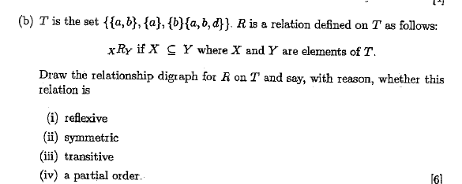

Slide 3
The vertices of the digraph represented sets: {a}, {b}, {a, b} and {a, b, d} and there were directed arcs between vertices when one set was a subset of the other.
Thus there was an arc from {a} to {a, b} and {a, b, d} but not from {a} to {b}.
This relation is reflexive, not symmetric and transitive.
As it is also anti-symmetric it is a partial order.

